Slide 1
Digital Logic Design
Chapter 4 : combinational Logic

Slide 2
Combinational Logic
Definition
Analysis
Design
Adder - Subtractor
Multiplier
Decoders-Encoders
Multiplexers

Slide 3
Combinational vs. Sequential
Logic circuits for digital systems can be combinational or sequential.
  A combinational circuit consists of logic gates whose outputs at any time are determined from the present combination of inputs.
    It performs an operation that can be specified logically by a set of Boolean functions.
  Sequential circuits use storage elements in addition to gates and their outputs are a function of the inputs and the state of the storage elements.
    The circuit behavior is based on timing sequences because the output value depends on the current input values and the previous input values.

Slide 4
Combinational Circuits
A combinational circuit consists of:
  input variables.
  logic gates.
  output variables.
The logic gates take inputs and generate signals to the outputs.
Each input and output signal exists as a binary signal that represents logic-1 and logic-0.

Slide 5
Notes on Combinational Circuits
For n input variables, there are 2^{n} possible binary input combinations.
For each combination of inputs, there is only one output value.
A combinational circuit can be specified by:
  a single truth table.
  m Boolean functions, one for each output variable.

Slide 6
Integrated Circuits
There are a number of combinational circuits that are used quite often in the design of digital systems.
  These circuits are available in integrated circuits and are classified as standard components.
some of the most important standard combinational circuits including:
  Adders.
  Subtractors.
  Comparators.
  Decoders.
  Encoders.
  multiplexers.

Slide 7
Analysis Procedure
The analysis of a combinational circuit requires that we determine the function that the circuit implements:
  The first step is to ensure that the circuit is combinational and not sequential.
      Combinational circuits have no memory elements and no feedback paths.
  The second step is to determine the Boolean functions or truth table.

Slide 8
Obtaining Boolean Functions
To obtain the output Boolean functions from a circuit diagram:
  Label all gate outputs that are a function of input variables with arbitrary symbols and determine the Boolean functions for each gate output.
  Label the gates that are a function of input variables and previously labeled gates with other arbitrary symbols, and find the Boolean functions for these gates.
  Repeat the process outlined in step 2 until the outputs of the circuit are obtained.
  By repeated substitutions of previously defined functions, obtain the output Boolean functions in terms of input variables.

Slide 9
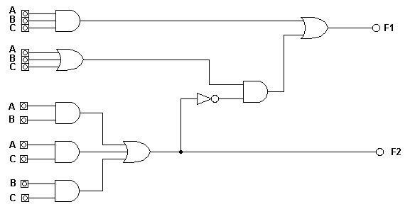
An Example
T₂
T₁
T₃
F₂’
T₁ = A + B + C
T₂ = ABC
F₂ = AB + AC + BC
T₃ = F₂’T1
F₁ = T₃ + T₂

Slide 10
Example Continued
Perform substitution to determine the output functions:
  F₁ = T₃ + T₂
  = F₂’T₁ + ABC
  = (AB + AC + BC)’(A + B + C) + ABC
  = (A’ + B’)(A’ + C’)(B’ + C’)(A + B + C) + ABC
  = (A’ + B’C’)(AB’ + AC’ + BC’ + B’C) + ABC
  = A’BC’ + A’B’C + AB’C’ + ABC

Slide 11
Determining a Truth Table
To obtain the truth table directly from a circuit diagram:
  Determine the number of input variables in the circuit.
  Label the outputs of selected gates with arbitrary symbols.
  Obtain the truth table for the outputs of those gates that are a function of the input variables only.
  Proceed to obtain the truth table for the outputs of those gates that are a function of previously defined values until the columns for all outputs are determined.

Slide 12
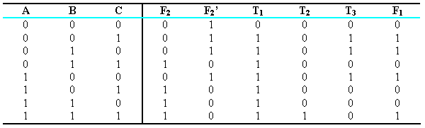
Example Truth Table
T₂
T₁
T₃
F₂’

Slide 13
Design Procedure
The design of combinational circuits starts from the specification of the problem and results in a logic diagram or a set of Boolean functions.
The steps to be followed are:
  From the specification, determine the required number of inputs and outputs and assign a symbol to each.
  Derive the truth table that defines the required relationship between inputs and outputs.
  Obtain the simplified Boolean functions for each output as a function of the input variables.
  Draw the logic diagram and verify the correctness of the design.

Slide 14
Simplification
Simplification of the output functions can be done in any of a number of ways:
  algebraic manipulation.
  map method.
  computer-based simplification.
You need to consider the following in your simplification:
  number of gates.
  number of inputs to a gate.
  propagation of time through the gates.
  number of interconnections.
  various others.

Slide 15
Design Examples
Design a combinational circuit to check if an input is greater than or equal to 5?
  The circuit that has a 3-bit binary input and a single output (Z) specified as follows:
    Z = 0, when the input is less than 5₁₀
    Z = 1, otherwise

Slide 16
Design Examples(Cont.)
Determine the inputs and Outputs
  Label the inputs (3 bits) as A, B, C
    A is the most significant bit
    C is the least significant bit
  The output (1 bit) is Z
    Z = 1 → 101₂, 110₂, 111₂
    Z = 0 → other inputs

Slide 17
Design Examples(Cont.)
Derive the Truth Table
A | B | C | Z
0 | 0 | 0 | 0
0 | 0 | 1 | 0
0 | 1 | 0 | 0
0 | 1 | 1 | 0
1 | 0 | 0 | 0
1 | 0 | 1 | 1
1 | 1 | 0 | 1
1 | 1 | 1 | 1
∑(5,6,7)

Slide 18
Design Examples(Cont.)
Simplify the Boolean Expression (using k-map)
F= ∑(5,6,7)
B
 | 1 | 1 | 1
F=AC+AB
A
c
c
C
AC
AB

Slide 19
Design Examples(Cont.)
  Draw the logic diagram that represents the simplified Boolean expression.
F=AC+AB
A
C
F
A
B

Slide 20
K-map
B
3-Variables
A
C
C
4-Variables
B
A
D

Slide 21
Homework1
Design a combinational circuit with three inputs and one output. The output is 1 when the binary value of the inputs is less than 3. The output is 0 otherwise.

Slide 22
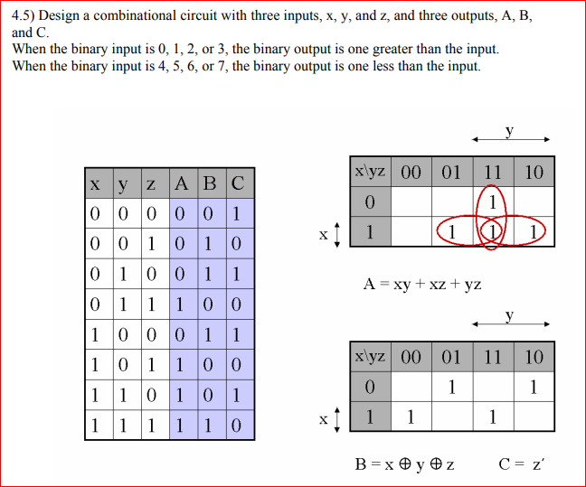

Slide 23
Binary Adder-Subtractor
Digital computers must perform basic arithmetic operations.
  0 + 0 = 0.
  0 + 1 = 1.
  1 + 0 = 1.
  1 + 1 = 10 Note: the higher order bit is a carry.
A combinational circuit that performs addition for two bits is called a half adder.
A combinational circuit that performs addition of three bits is a full adder.
  Two half adders can be combined to create a full adder.
A binary adder-subtractor performs both addition and subtraction with binary numbers.

Slide 24
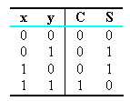
Half Adder
A half adder requires the following:
  two binary inputs.
  two binary outputs.
S = x’y + xy’
C = xy

Slide 25
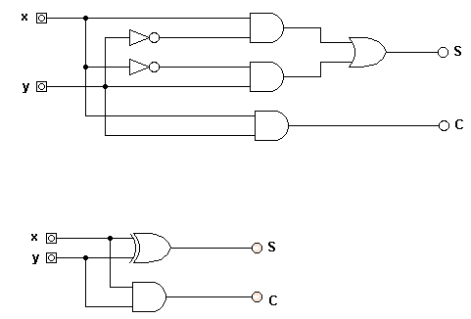
Half Adder Circuit
S = xy’ + x’y
C = xy
S = x ⊕ y
C = xy

Slide 26
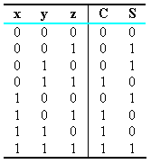
Full Adder
A full-adder forms the sum of three bits
  Two inputs (x and y) represent the two significant bits to be added
  The third input (z) represents the carry from the previous lower significant position
  Two outputs are necessary because the sum ranges from 0 to 3
S = x’y’z + x’yz’ + xy’z’ + xyz
C = xy + xz + yz

Slide 27
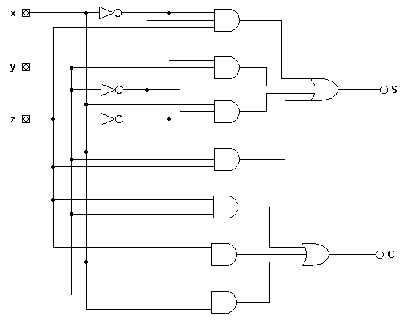
Full Adder (SOP)

Slide 28
Binary Adder
A binary adder is a circuit that sums two binary numbers.
  It can be created with full adders connected in cascade, with the output carry from each full adder connected to the input carry of the next full adder in the chain.

Slide 29
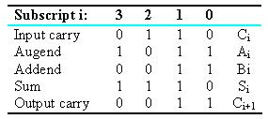
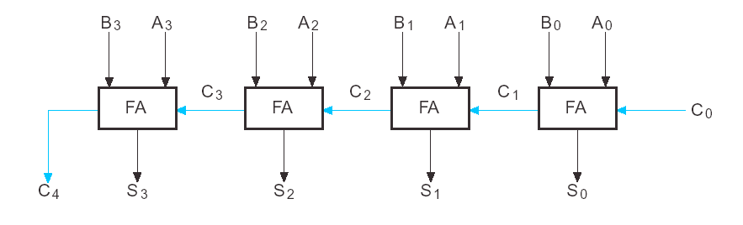
Binary Adder

Slide 30
Binary Subtractor
The subtraction of unsigned binary numbers can be done by means of complements.
  The circuit for subtracting A – B consists of an adder with inverters placed between each data input B and the corresponding input of the full adder.
  The input carry C₀ must be 1 when performing subtraction.
  This performs the operation of A plus the 1’s complement of B plus 1.
  A – B if A >= B.
  2’s complement of (B – A) if A < B.
The same circuit can be used for signed numbers provided that there is no overflow.

Slide 31

Binary Subtractor
C₀ = 1

Slide 32
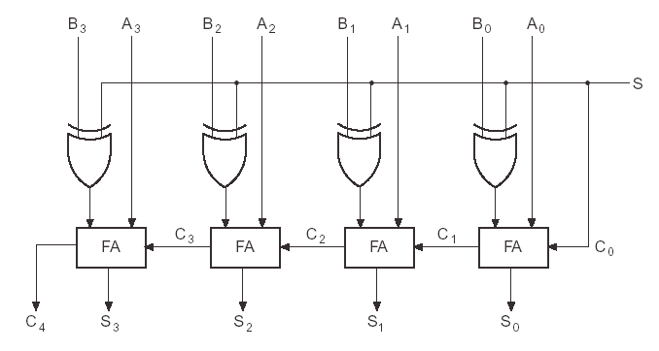
Adder Subtractor
The addition and subtraction operations can be combined into one circuit with one common binary adder.
  This is done by including an exclusive-OR gate with each full adder.
M

Slide 33
Overflow
Overflow occurs when two numbers of n digits each are added and the sum occupies n + 1 digits.
  In digital computers, we are limited in size by the outputs.
The detection of an overflow after the addition of two binary numbers depends on whether the numbers are considered to be signed or unsigned.
  When two unsigned numbers are added, an overflow is detected from the end carry out of the most significant position.
  When two signed numbers are added, the leftmost bit always represents the sign and negative numbers are in 2’s complement form. Thus the sign bit is treated as part of the number and the end carry does not indicate an overflow.

Slide 34
Decoders
A decoder is a circuit that converts binary information from n input lines to a maximum of 2^{n} unique output lines.
  If the n-bit coded information has unused combinations, the decoder may have fewer than 2^{n} outputs.

Slide 35
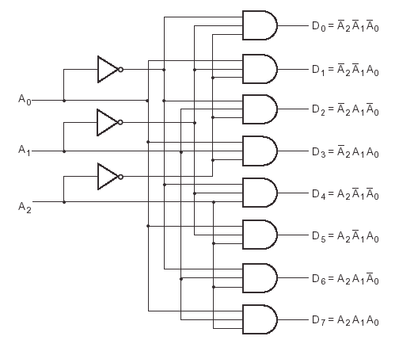
3-to-8 Line Decoder
x’y’z’
x’y’z
z
x’yz’
y
x’yz
x
xy’z’
xy’z
xyz’
xyz

Slide 36
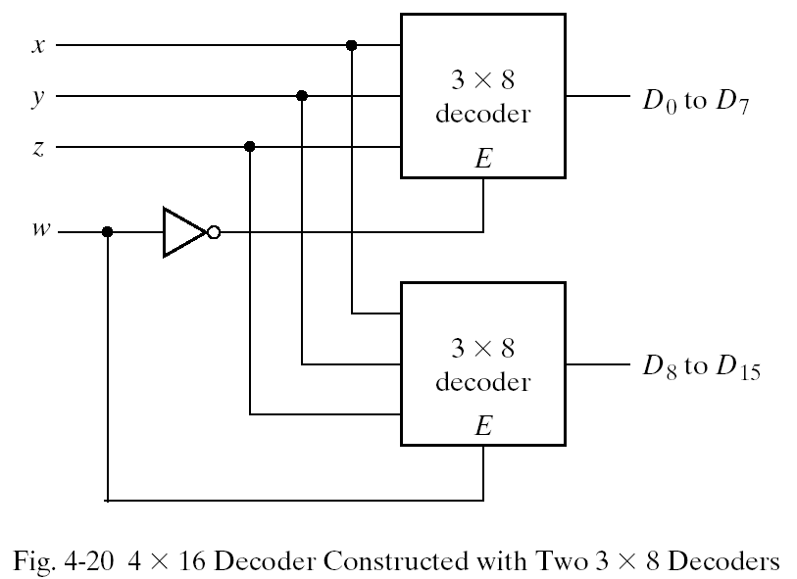
Implementing 4x16 Decoder

Slide 37
Combinational Logic Implementation
Any function can be represented by sum of minterms and since a decoder represents minterms, it is possible to use the decoder and external OR gates to form logical sums.
  Any combinational circuit with n inputs and m outputs can be implemented by a n - to-2^{n}-line decoder and m OR gates.

Slide 38
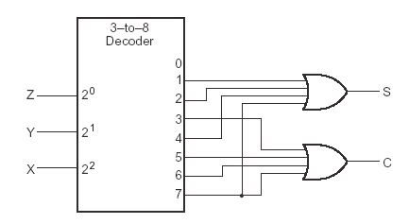
Implementing a Full Adder With a Decoder
Remember that full adder has two outputs, the sum and the carry:
  S(x, y, z) = (1, 2, 4, 7)
  C(x, y, z) = (3, 5, 6, 7)

Slide 39
Encoders
An encoder is a circuit that performs the inverse operation of a decoder.
  It has 2^{n} (or fewer) input lines and n output lines.
  The output lines generate the binary code corresponding to the input value.

Slide 40
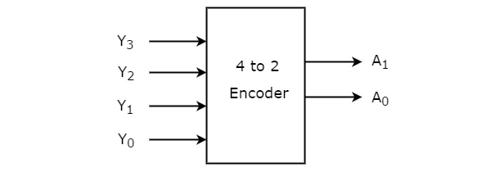
Encoders
4 to 2 Encoder
Let 4 to 2 Encoder has four inputs Y₃, Y₂, Y₁ & Y₀ and two outputs A₁ & A₀.
At any time, only one of these 4 inputs can be ‘1’ in order to get the respective binary code at the output.

Slide 41
Encoders
Inputs |  |  |  | Outputs
Y₃ | Y₂ | Y₁ | Y₀ | A₁ | A₀
0 | 0 | 0 | 1 | 0 | 0
0 | 0 | 1 | 0 | 0 | 1
0 | 1 | 0 | 0 | 1 | 0
1 | 0 | 0 | 0 | 1 | 1
At any time, only one of these 4 inputs can be ‘1’ in order to get the respective binary code at the output.

Slide 42
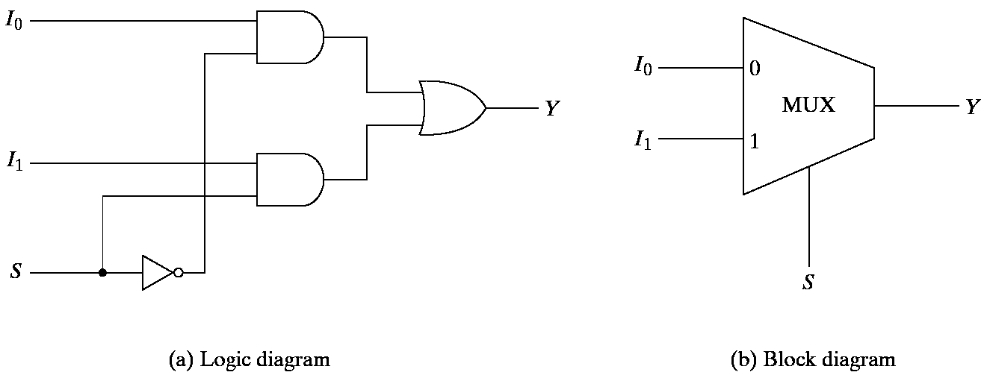
Multiplexer
A multiplexer is a circuit that selects binary information from one of many input lines and directs it to a single output line.
  The selection of a particular input line is controlled by a set of selection lines.
  Normally, there are 2^{n} input lines and n selection lines whose bit combinations determine which input is selected.

Slide 43
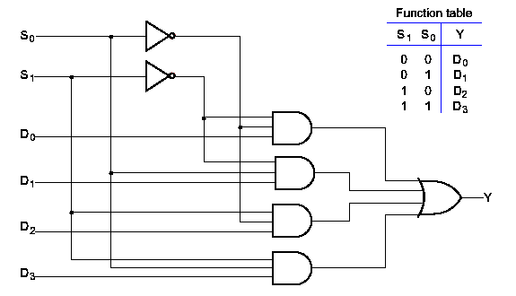
4 To 1 Line MUX

